Slide 1



Algorithmic Vision Lane Detection
Objective
Objective translates raw pixel data into mathematical line equations.
Core Problem
Core problem is computers see matrices of numbers, not roads.
Solution Pipeline
Solution pipeline combines Canny Edge Detection and Hough Transform.
Notes:
1

Slide 2
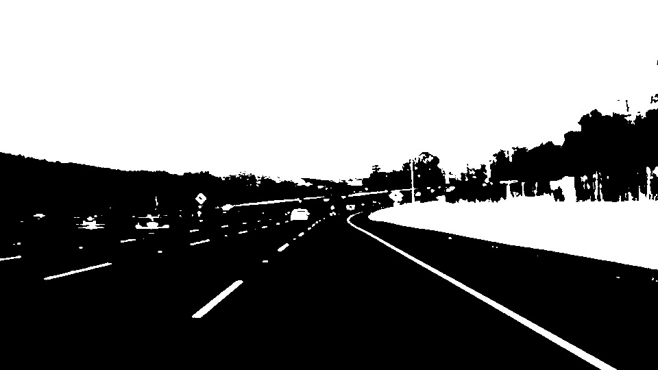
Why Basic Thresholding Fails
Global thresholding assumes uniform lighting.
Shadows and road textures destroy basic binary segmentation.
Conclusion mandates looking for edges, not raw intensity values.
Notes:
2

Slide 3
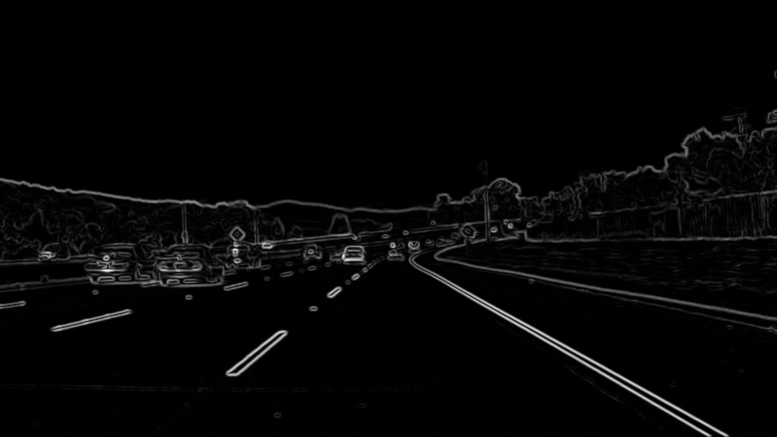
Gradients and Noise Reduction
Step 1 of Canny
01
02
Grayscale reduces computational load.
Gaussian blur removes high frequency noise causing false edges.
03
Sobel operators highlight rapid intensity changes in x and y directions.
Notes:
3

Slide 4
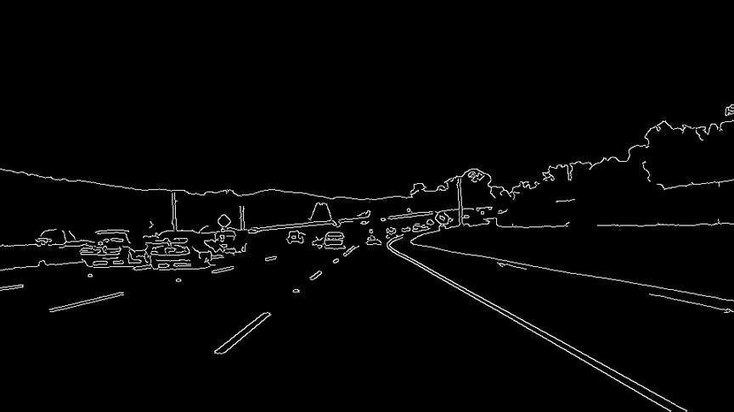
Non Maximum Suppression and Hysteresis
Step 2 of Canny
Thick edges are useless for precision.
Non maximum suppression thins edges to a single pixel.
Hysteresis uses two thresholds where strong pixels survive and weak pixels survive only if connected to strong ones.
Notes:
4

Slide 5
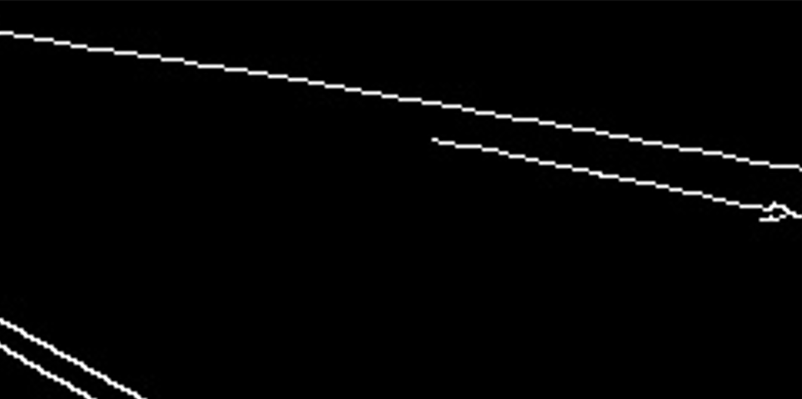
Pixels Versus Structure
The Gap Between Edges and Geometry
Canny outputs a binary edge map but lacks structural understanding.
Edge points exist in Cartesian space.
Navigation requires geometric equations of lines.
Notes:
5

Slide 6
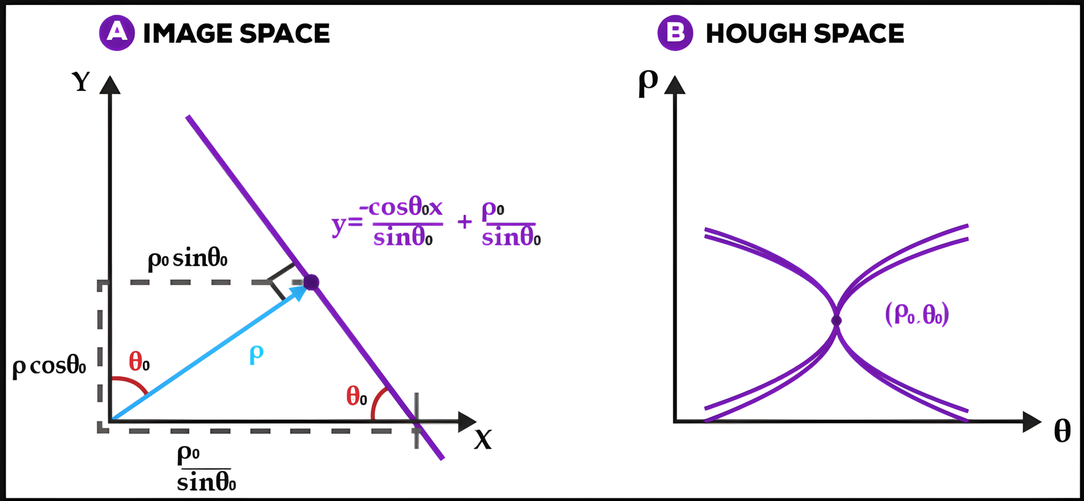
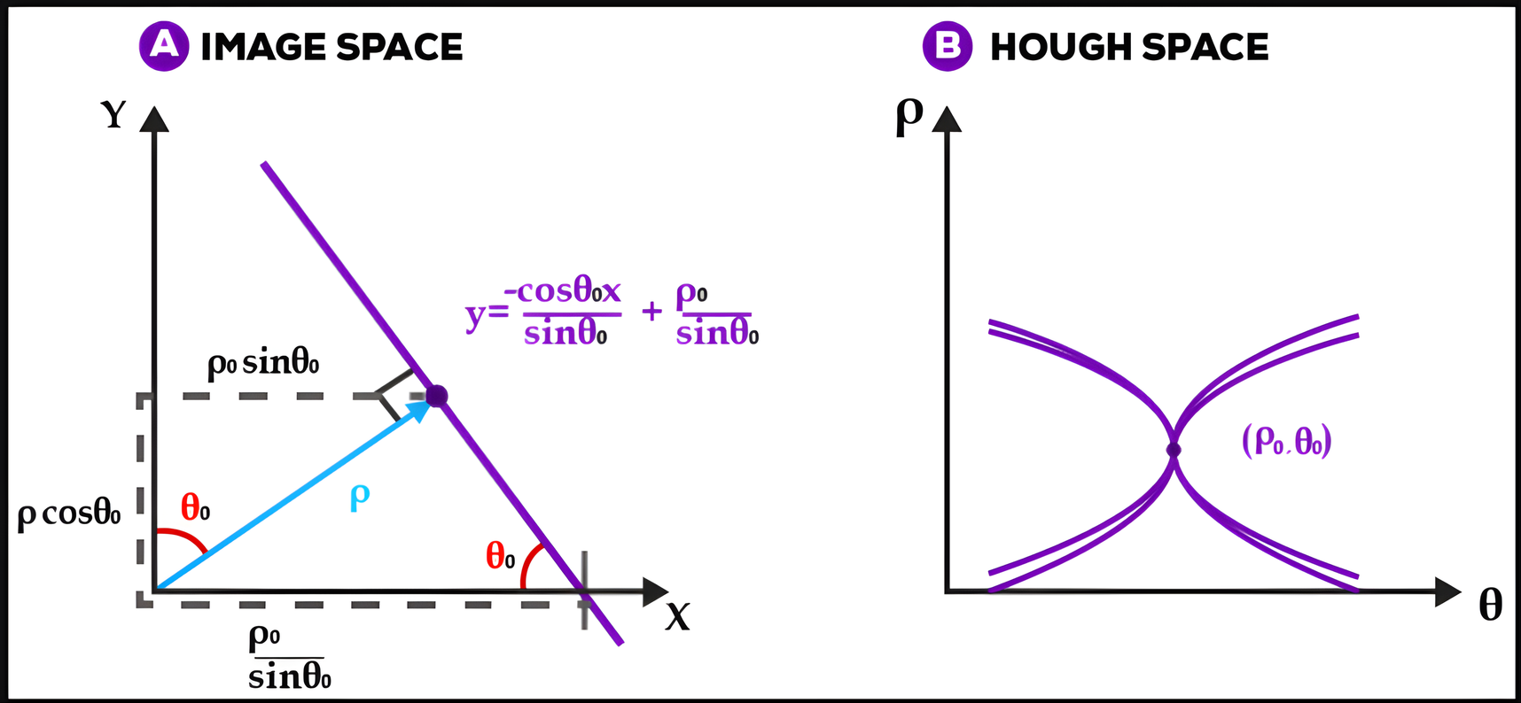
The Hough Transform Mathematics
Cartesian to Polar
Representing lines with slope intercept fails for vertical lines.
Solution uses polar coordinates.
A single point in image space maps to a sinusoidal curve in Hough space.
Notes:
6

Slide 7
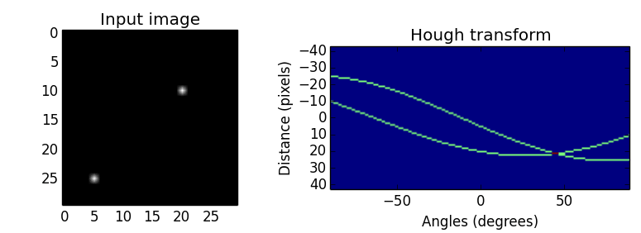
Accumulator Matrix
The Hough Transform Voting System
Every Canny edge pixel votes for all possible intersecting lines.
Pixels on the same physical line have intersecting sinusoidal curves in Hough space.
Highest matrix votes equal the strongest lines in the image.
Notes:
7

Slide 8

ROI and Computational Efficiency
Optimization Region of Interest
Processing 1080p frames at 60fps crashes basic hardware.
Solution masks everything except the immediate road ahead.
Demonstrates practical engineering overriding pure theory.
Notes:
8

Slide 9
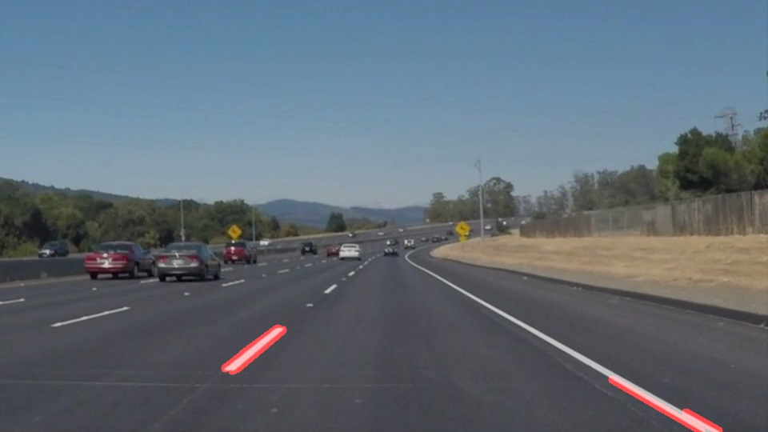
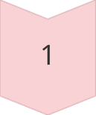
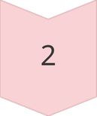
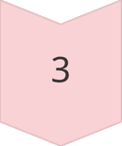
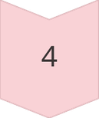
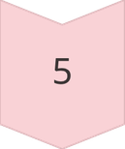
System Pipeline Execution
The Complete Pipeline Execution
Blur
Canny
ROI
Hough
Overlay
Full flow moves from Blur to Canny to ROI to Hough to Overlay.
System handles dashed lines because Hough Transform bridges gaps mathematically.
Notes:
9

Slide 10

Limitations of Classical DSP
Where Classical DSP Fails
Hough Transform relies on rigid geometry and fails on sharp curves.
Environmental noise destroys the Canny edge map.
Warrants the transition to Convolutional Neural Networks in modern systems.
Notes:
10

